Slide 1
COURSE OVERVIEW INTRODUCTION TO DATABASES
Database Concepts
Spring 2021
Week 1

Slide 2
Teaching staff
▪▪ Instructor : Bader Albahlal
bma16d@my.fsu.edu
Office hours: by appointment

Slide 3
Course objectives
▪▪ Learn
Basic database concepts and theories
Basic data modeling principles
How to build database systems
▪▪ Practice
Database design using MySQL Workbench
Database implementation skills
Structured Query Language (SQL)

Slide 4
Course requirements
▪▪ Required Textbook
Database Systems: Design, Implementation, and Management 11th Ed. Carlos Coronel and Steven Morris
Cengage Learning, ISBN: 1285196147
▪▪ Grading
Five Individual Assignments
Two Individual/Group Projects
Two Exams
Five Quizzes
Three Class Activities
Attendance
5@ 100 pts (500 points) 35%
2@ 100 pts (200 points) 23%
2@ 100 pts (200 points) 24%
5@ 100 pts (500 points) 5%
3@ 100 pts (300 points) 3%
10%

Slide 5
Individual Assignment Guideline
Must be submitted through Canvas
The assignments can and should be done prior to submitting.
The assignment must be completed the first time when it is launched. You cannot save it, then re-open it up later to finish it.
It is the student’s responsibility to check their FSU e-mail on a daily basis. All course e-mail will be sent only through valid FSU e-mail addresses.

Slide 6
Individual Assignment Guideline
Follow the rubric carefully (projects)
Review before submission- No resubmission!
Assignments have a 75 minutes time limit, once the assignment button is activated.
Turn in assignments on time according to the specific instruction
Ten percentage-points will be deducted for every day you are late with an assignment or project (20% penalty)
Assignments submitted later than 48 hours will not be accepted.

Slide 7
Course resources
▪▪ Canvas course website
All necessary materials, information available on that site
Course slides and Book Chapters are available under “Course Library”
▪▪ SQL tutorial
W3schools.com ( http://www.w3schools.com/sql/default.asp )

Slide 8
Database Systems

Slide 9
Why Databases? What are databases?
Collection, storage, aggregation, manipulation, dissemination, and management of data
Definitions
“specialized structures that allow computer-based systems to store, manage, and retrieve data quickly”
“an organized collection of data stored in a safe and secure location”
“a collection of interrelated data items that are managed as a single unit”

Slide 10
The Characteristics of Databases
Data is stored in tables, which have rows and columns like a spreadsheet. A database may have multiple tables, where each table stores data about a different thing.
Each row in a table stores data about an instance of the thing of interest ( records).
A database stores data.

Slide 11
Data vs. Information
Data | Information
Data is raw, unorganized facts that need to be processed. Data can be something simple and seemingly random and useless until it is organized. | When data is processed, organized, structured or presented in a given context so as to make it useful, it is called information.
Each student's test score is one piece of data. | The average score of a class or of the entire school is information that can be derived from the given data.
Raw facts
Raw data - Not yet been processed to reveal the meaning
Building blocks of information
Produced by processing data
Reveals the meaning of data
Enables knowledge creation
Should be accurate, relevant, and timely to enable good decision making
Notes:
Databases Create Information
Data = recorded facts and figures
Information = knowledge derived from data
Databases record data, but they do so in such a way that we can produce information from the data.
The data on STUDENTs, CLASSes, and GRADEs could produce information about each student’s GPA.

Slide 12
File Terminology
Term | Definition
Data | Raw facts, such as a telephone number, a birth date, a customer name, and a year-to-date (YTD) sales value. Data have little meaning unless they have been organized in some logical manner.
Field | A character or group of characters (alphabetic or numeric) that has a specific meaning. A field is used to define and store data.
Record | A logically connected set of one or more fields that describes a person, place, or thing. For example, the fields that constitute a record for a customer might consist of the customer’s name, address, phone number, date of birth, credit limit, and unpaid balance.
File | A collection of related records. For example, a file might contain data about the students currently enrolled at FSU.

Slide 13
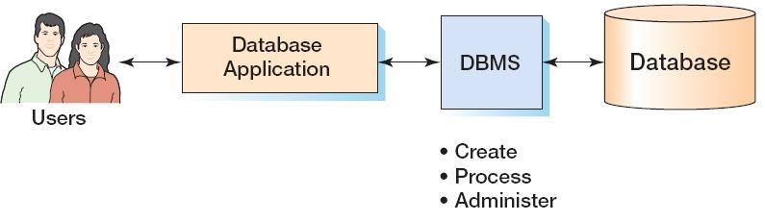
Components of a Database System
Five components of database systems (pp.20-21)
Hardware, Software, People, Procedure, and Data
KROENKE AND AUER - DATABASE PROCESSING, 13th Edition © 2014 Pearson Education, Inc.

Slide 14
Database Applications
Database Applications are the computer programs that users work with to access data within the database to generate reports

Slide 15
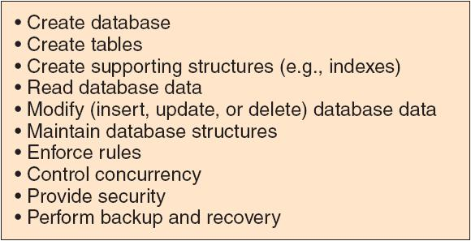
DBMS
The Database Management System (DBMS) creates, processes,
and administers databases.

Slide 16
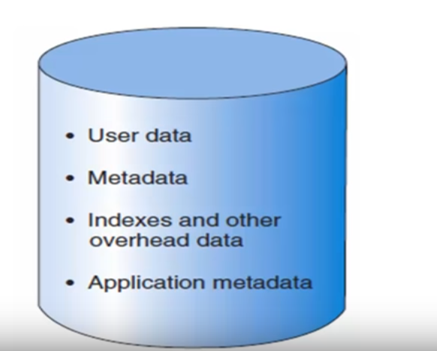
Database Contents
A database stores a collection of:
End-user data - Raw facts of interest to end user
Metadata: Data about data, which the end-user data are integrated and managed

Slide 17
Types of databases
Classified by (pp.9-10) (*review definitions)
the number of users supported
a single-user/a desktop/a workgroup/an enterprise database
where the data are located
a centralized/a distributed/a cloud database
the type of data stored
general-purpose/discipline-specific databases
the intended data usage
an operational/analytical database
the degree to which the data are structured
Unstructured/structured databases

Slide 18
From File Systems to Database Systems

Slide 19
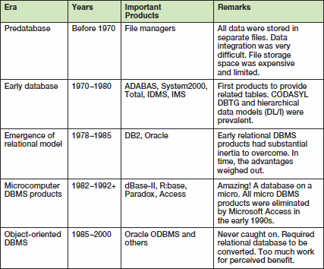
A Brief History of Database Processing I

Slide 20



Evolution of File System Data Processing
Manual File Systems
Accomplished through a system of file folders and filing cabinets
Computerized File Systems
Data processing (DP) specialist: Created a computer-based system that would track data and produce required reports
File System Redux: Modern End-User Productivity Tools
Includes spreadsheet programs such as Microsoft Excel

Slide 21


Problems with File System Data Processing
Lengthy development times
Difficulty of getting quick answers
Complex system administration
Lack of security and limited data sharing
Extensive programming

Slide 22
Problems with File System Data Processing
Structural dependence
Data dependence
Data redundancy

Slide 23
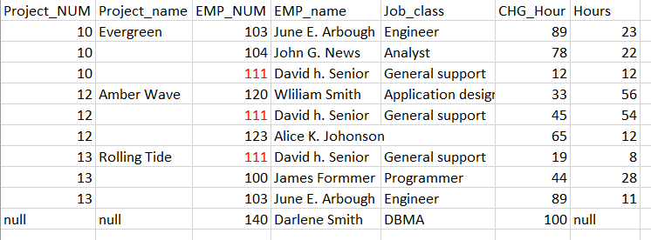
Problems with File System Data Processing

Slide 24
Structural and Data Dependence
Structural dependence
Access to a file is dependent on its own structure
A change in any file’s structure requires the modification of all programs using that file
Structural independence
File structure is changed without affecting the application’s ability to access the data
Notes:
changing just one field in the original CUSTOMER file would require a program that:
1. Reads a record from the original file.
2. Transforms the original data to conform to the new structure’s storage requirements.
3. Writes the transformed data into the new file structure.
4. Repeats the preceding steps for each record in the original file.

Slide 25
Structural and Data Dependence
Data dependence
A change in any file’s data storage characteristics requires changes of all data access programs.
Data independence
Data storage characteristics is changed without affecting the program’s ability to access the data

Slide 26
Data Redundancy
▪▪ Unnecessarily storing same data at different places
▪▪ Islands of information: Scattered data locations
▪▪ Increases the probability of having different versions of the same data

Slide 27
Data Redundancy Implications
Data inconsistency: Exists when different and conflicting versions of the same data appear in different places.
Increased likelihood of data-entry errors when complex entries are made in different files
Data anomaly: Develops when not all of the required changes in the redundant data are made successfully
Notes:
Having multiple copies of data increases the chances for a copy of the data to unauthorized access.

Slide 28
Database Management System (DBMS)
Collection of programs
Manages the database structure
Controls access to data stored in the database
Notes:
A database management system (DBMS) is a collection of programs that manages the database structure and controls access to the data stored in the database.

Slide 29
Role of the DBMS
Intermediary between the user and the database
Enables data to be shared
Presents the end user with an integrated view of the data
Receives and translates application requests into operations required to fulfill the requests
Hides database’s internal complexity from the application programs and users
Notes:
The DBMS serves as the intermediary between the user and the database.

Slide 30
Advantages of the DBMS
Improved:
▪▪ Data sharing
▪▪ Data security
▪▪ Data integration
▪▪ Minimized data inconsistency
▪▪ Data access
▪▪ End-user productivity
DBMS eliminates most of file system’s problems!

Slide 31
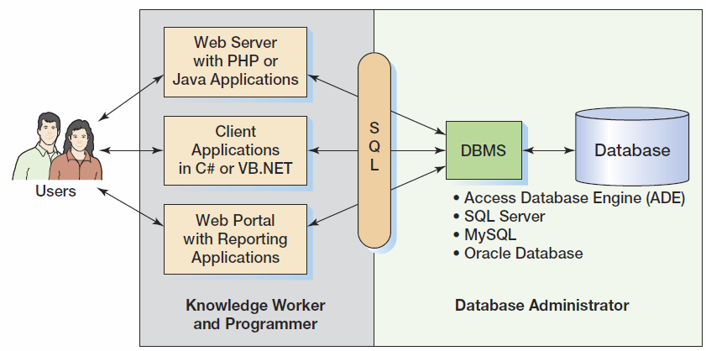
What You Need To Learn
KROENKE AND AUER - DATABASE PROCESSING, 13th Edition © 2014 Pearson Education, Inc.

Slide 32
Prominent DBMS Products
Microsoft Access 2019
Microsoft SQL Server 2018
Oracle Corporation Oracle Database 13g Release 2
MySQL 8.1
IBM DB2
https://db-engines.com/en/ranking
Notes:
You interact with DB through type of application. You can not interact with your DB directly and work on it.

Slide 33
MySQL Workbench
A graphical tool for working with MySQL Servers and databases.
Five main functions:
SQL Development
Data Modeling (Design)
Server Administration
Data Migration
MySQL Enterprise Support
Notes:
Any thing you learned here in class you can apply it in any DBMS products like Oracl or SQL server because they are all use SQL.

Slide 34
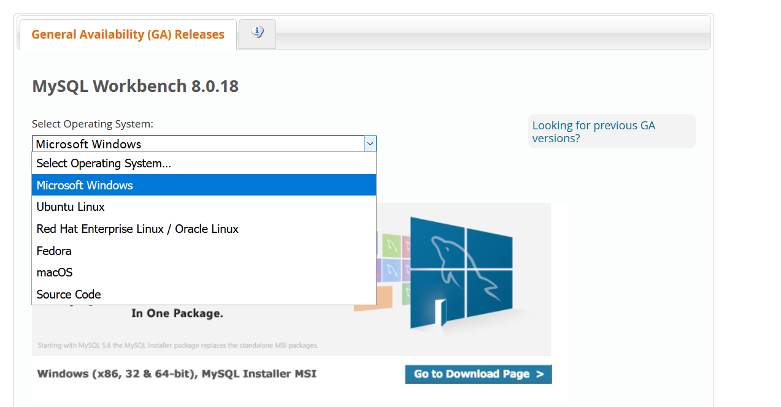
MySQL Workbench - download
Step 1
Go to “http://dev.mysql.com/downloads/workbench/”
Step 2
Choose your platform

Slide 35
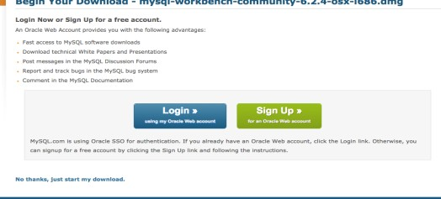
MySQL Workbench - download
If your platform is Windows, download either Windows (32-bit) or Windows (64-bit) noinstall ZIP Archive. Click “Download”
Step 3
Just click “No thanks, just start my download”

Slide 36
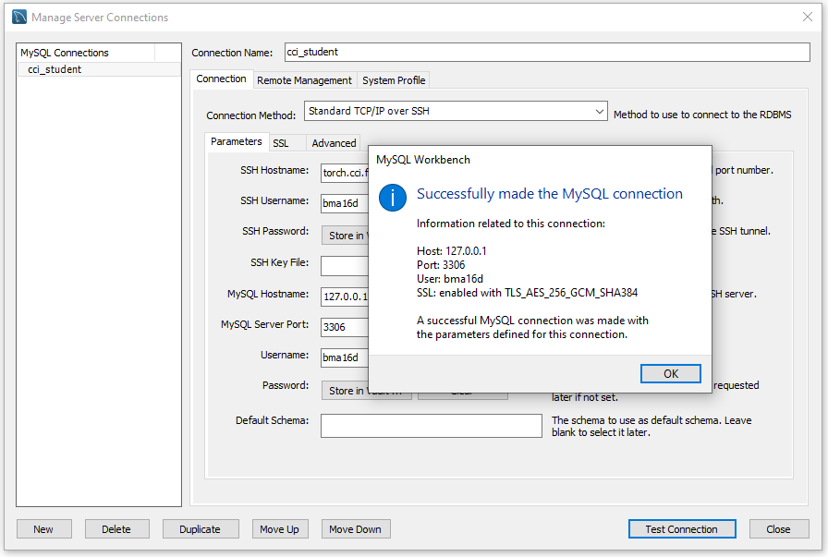
Then, create a new MySQL connection Finally, submit a screenshot of MySQL connections into class activity 1

